Slide 1
Data Science Salary Analysis
WELCOME
By: Sue Susman, MEd, BSN, RN

Slide 2

Hello! I’m...
Sue Susman
I’m a graduate student at Merrimack College in the MS Data Science Program.

Slide 3
01 Background
02
Data Overview
03
Data Cleaning
04
Data Visualization
05 Conclusion
Table of Contents

Slide 4
Background
My project is focused on attempting to understand various factors of data science positions that can affect salary (USD).
Is it possible to predict the a data scientist’s salary based on their company’s size, location, working remotely vs. in the office, job title, and experience level?

Slide 5
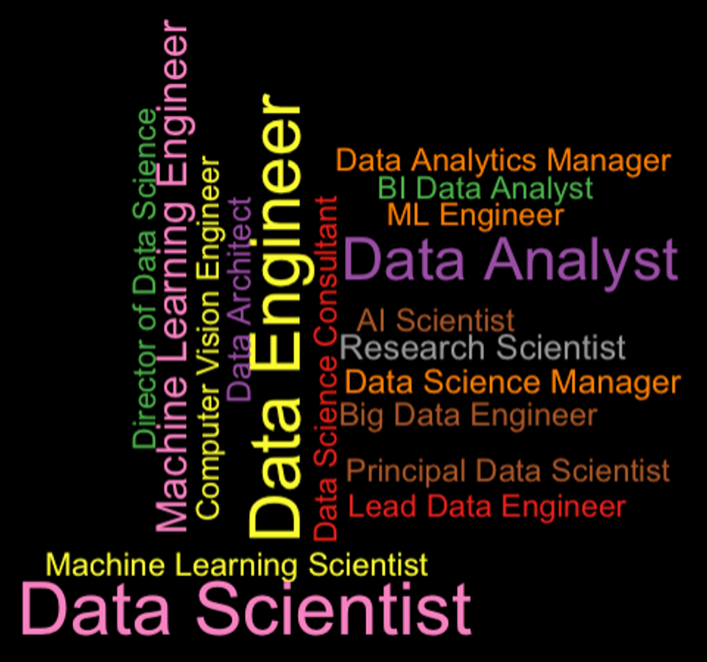
D A T A S C I E N C E J O B S
W O R D C L O U D

Slide 6
Data Overview
Column | Description
work_year | The year the salary was paid.
experience_level | The experience level in the job during the year with the following possible values: EN (Entry / Junior), MI (Mid / Intermediate), SE (Senior / Expert), EX (Executive / Director)
employment_type | The type of employment for the role: PT (Part-time), FT (Full-time), CT (Contract), FL (Freelance)
job_title | The role worked in during the year.
salary | The total gross salary amount paid.
salary_currency | The currency of the salary paid as an ISO 4217 currency code.
salary_in_usd | The salary in USD (FX rate divided by avg. USD rate for the respective year via fxdata.foorilla.com).
employee_residence | Employee's primary country of residence in during the work year as an ISO 3166 country code.
remote_ratio | The overall amount of work done remotely; possible values are as follows: 0% (No remote work (less than 20%)), 50% (Partially remote), 100% (Fully remote (more than 80%))
company_location | The country of the employer's main office or contracting branch as an ISO 3166 country code.
company_size | The average number of people that worked for the company during the year: S (less than 50 employees (small)), M (50 to 250 employees (medium)), L (more than 250 employees (large))

Slide 7
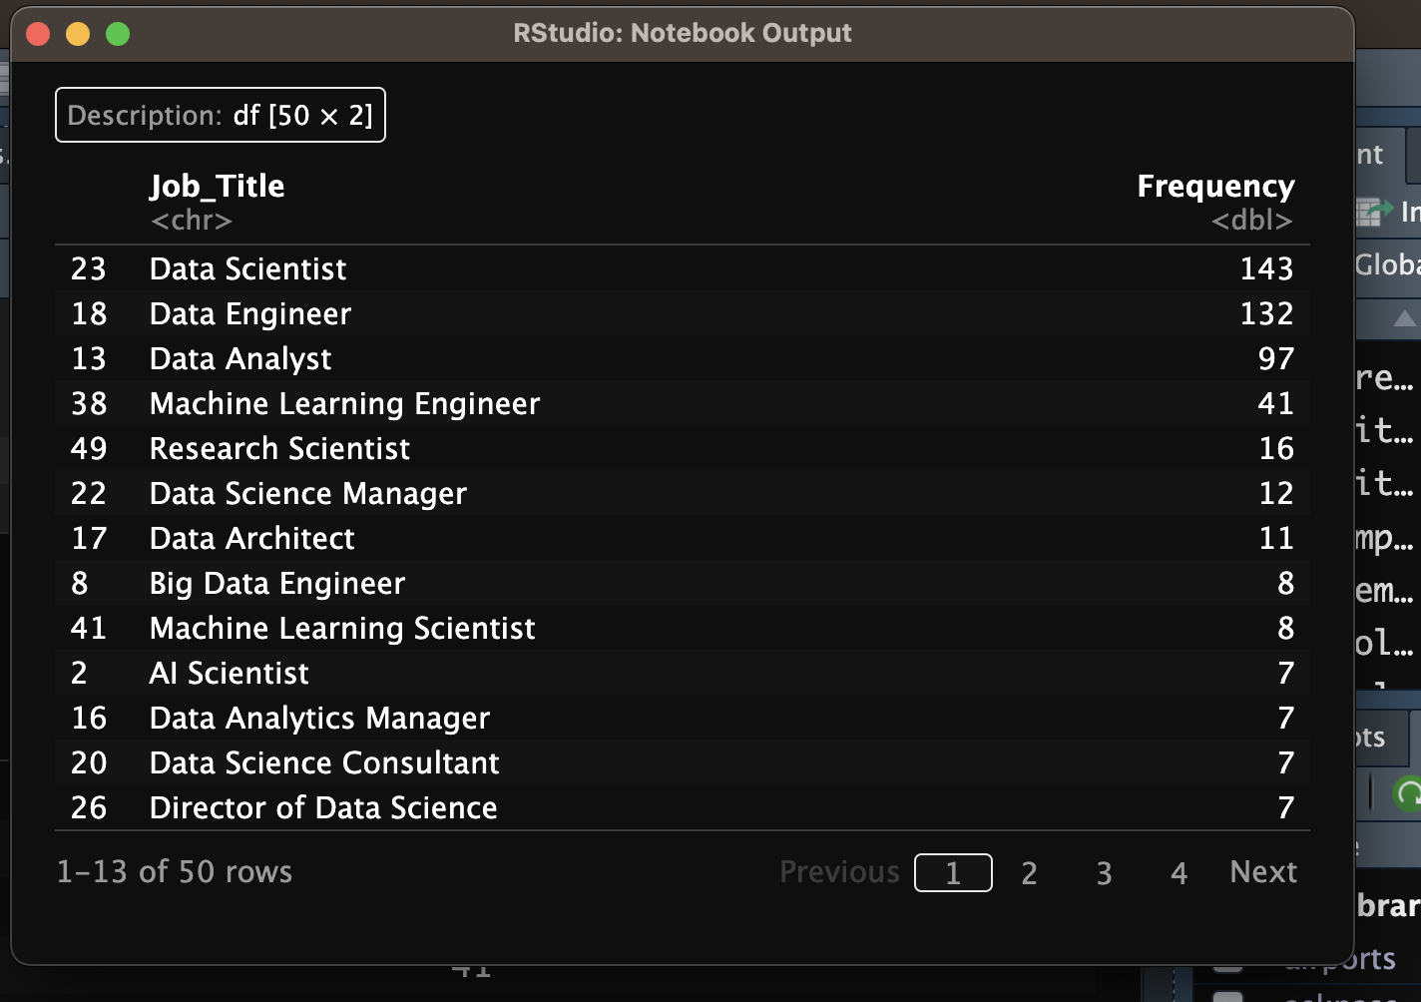
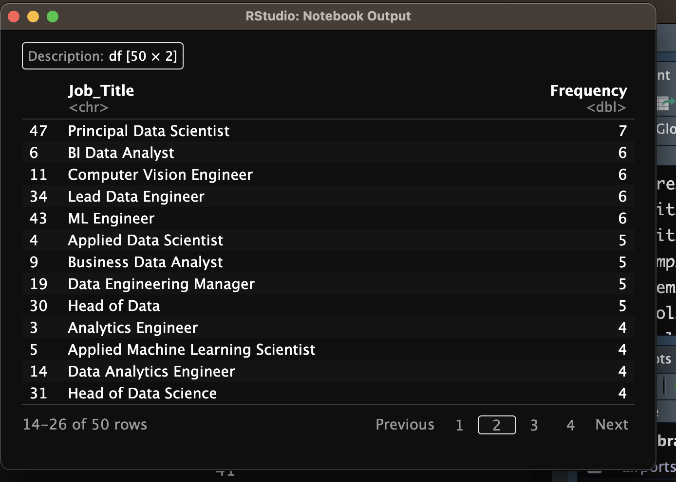
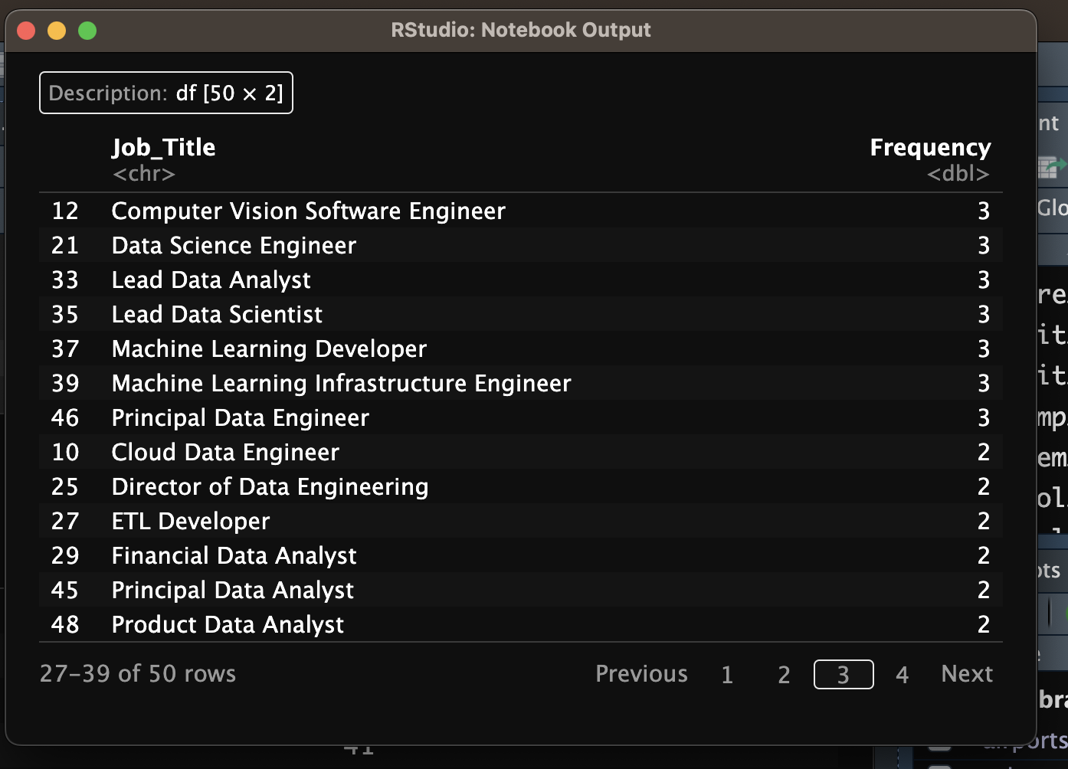
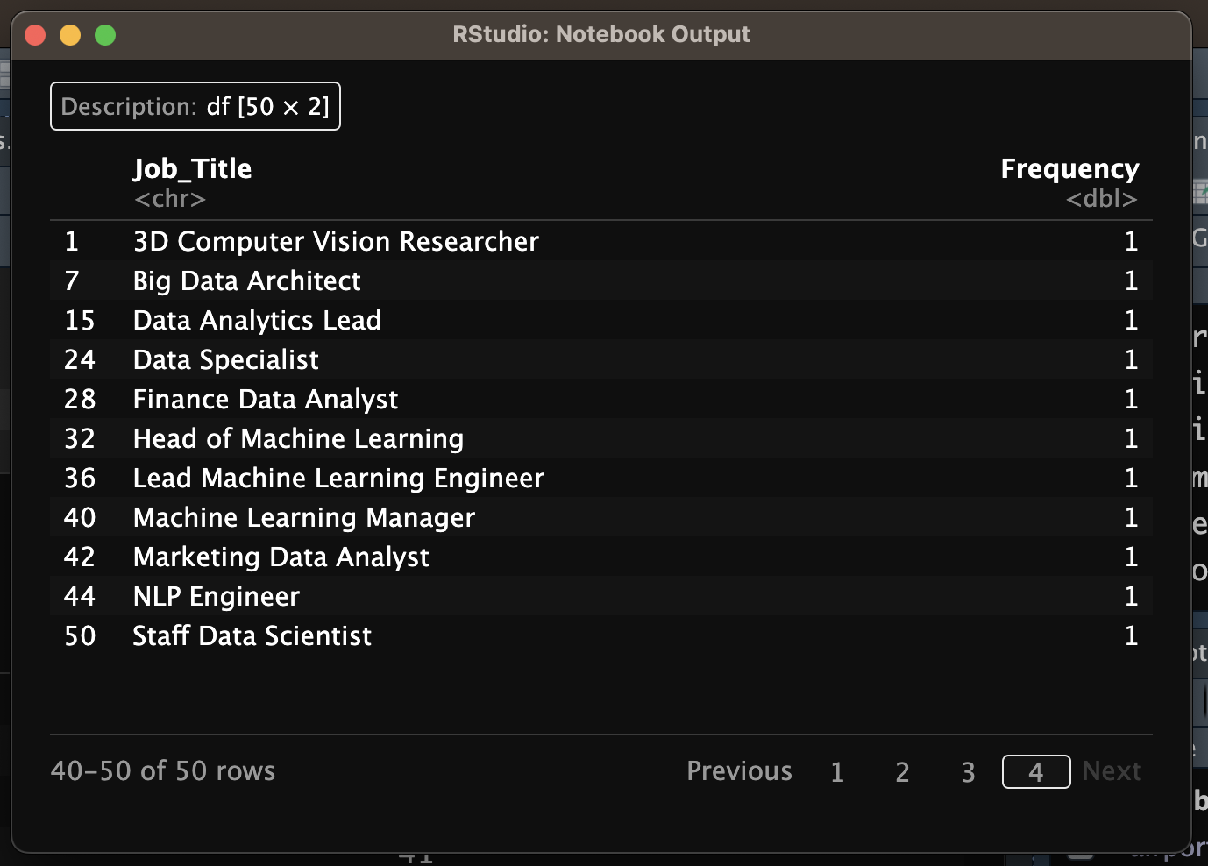
03
D A T A S C I E N C E
J O B T I T L E S

Slide 8
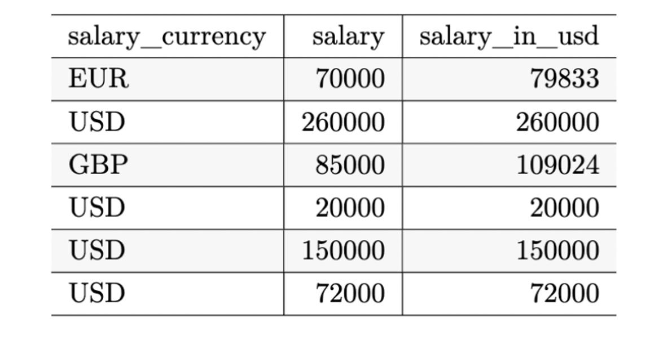

Data Cleaning
Salary, Currency, or Salary in USD?
Notes:
During this phase of the project, I decided to remove the “salary_currency” and “salary” columns and focus on just “salary_in_usd” since our company is located in the US.

Slide 9
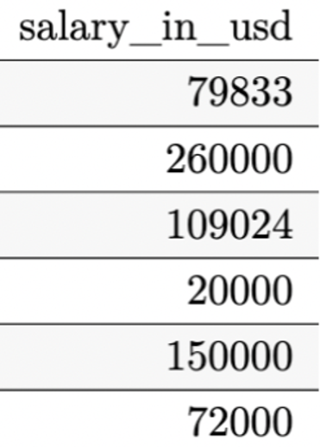



Salary in USD!!

Slide 10
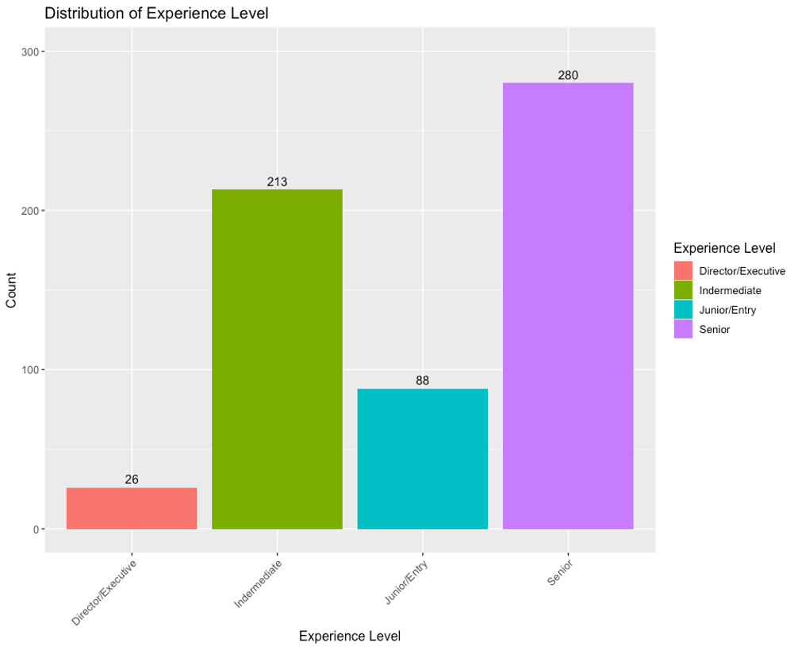
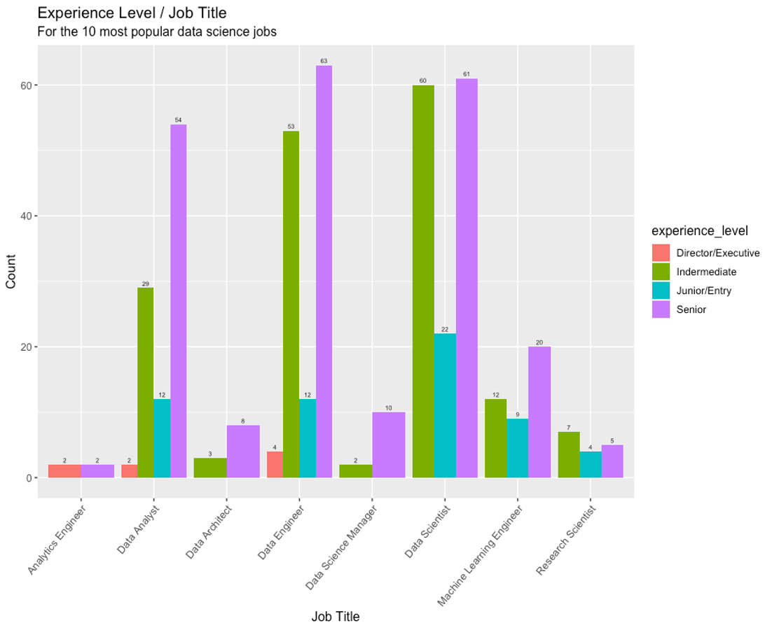
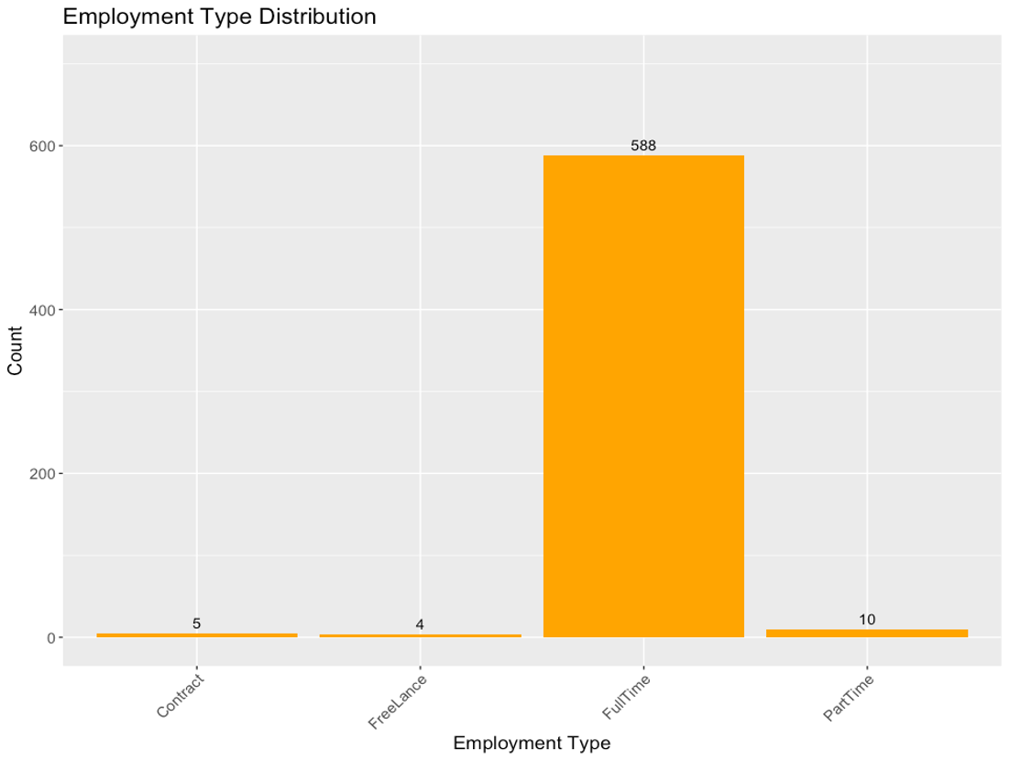
Data Visualization
Notes:
Distribution of Experience Level:
Director/Executive: 4.2%
MI/Intermediate: 35.1%
Junior/Entry Level: 14.5%
Senior: 46.1%
Experience Level by Job Title:
Analytics Engineer: 4
Director/Executive Level: 2 (50%)
Intermediate Level: 0
Junior/Entry Level: 0
Senior Level: 2 (50%)
Data Analyst: 97
Director/Executive Level: 2 (2.1%)
Intermediate Level: 29 (29.9%)
Junior/Entry Level: 12 (12.4%)
Senior Level: 54 (55.7%)
Data Architect: 11
Director/Executive Level: 0
Intermediate Level: 3 (27.3%)
Junior/Entry Level: 0
Senior Level: 8 (72.7%)
Data Engineer: 132
Director/Executive Level: 4 (3.0%)
Intermediate Level: 53 (40.2%)
Junior/Entry Level: 12 (9.1%)
Senior Level: 63 (47.7%)
Data Science Manager: 12
Director/Executive Level: 0
Intermediate Level: 2 (16.7%)
Junior/Entry Level: 0
Senior Level: 10 (83.3%)
Data Scientist: 143
Director/Executive Level: 0
Intermediate Level: 60 (42%)
Junior/Entry Level: 22 (15.4%)
Senior Level: 61 (42.7%)
Machine Learning Engineer: 41
Director/Executive Level: 0
Intermediate Level: 12 (29.3%)
Junior/Entry Level: 9 (22%)
Senior Level: 20 (48.8%)
Research Scientist: 16
Director/Executive Level: 0
Intermediate Level: 7 (43.8%)
Junior/Entry Level: 4 (25%)
Senior Level: 5 (31.3%)
Distribution of Employment Type: 607
Contract: 5 (0.8%)
Freelance: 4 (0.7%)
Full Time: 588 (96.9%)
Part Time: 10 (1.7%)

Slide 11
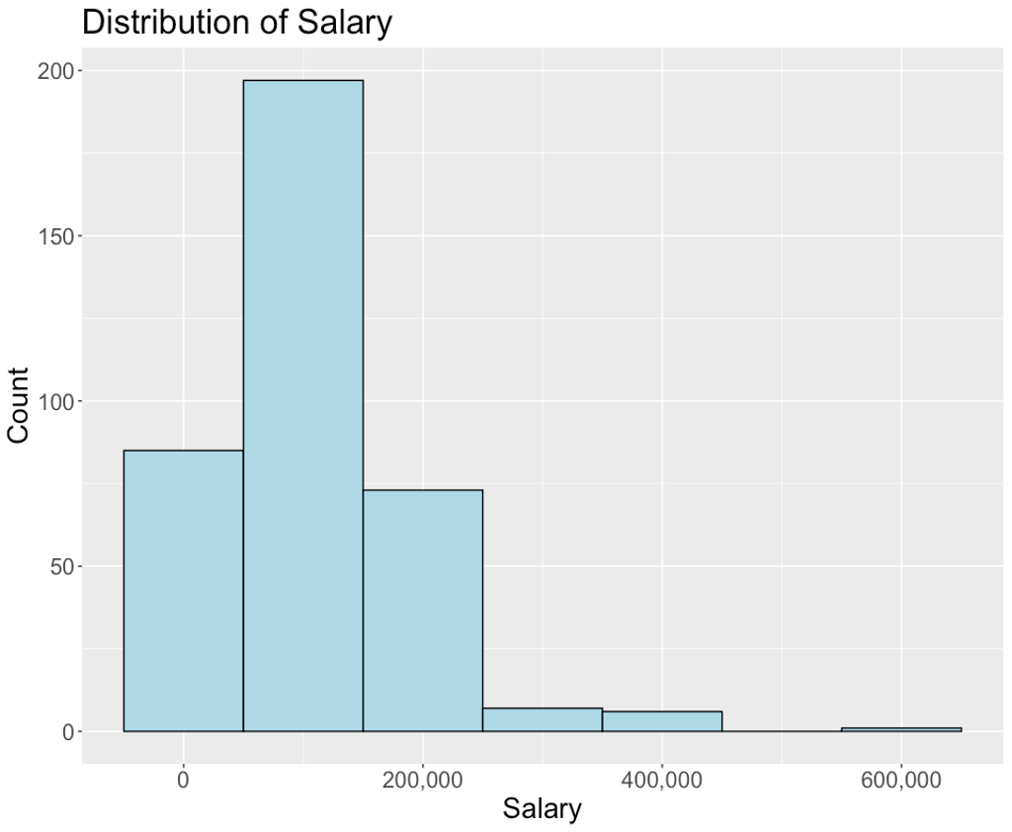
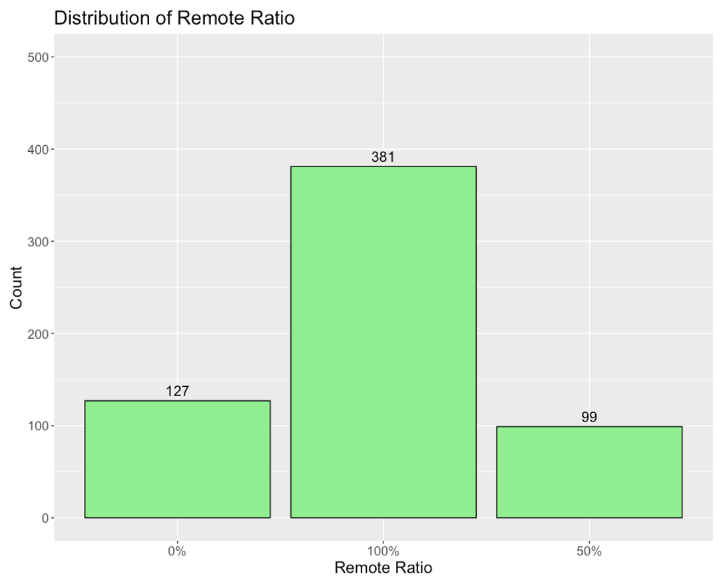
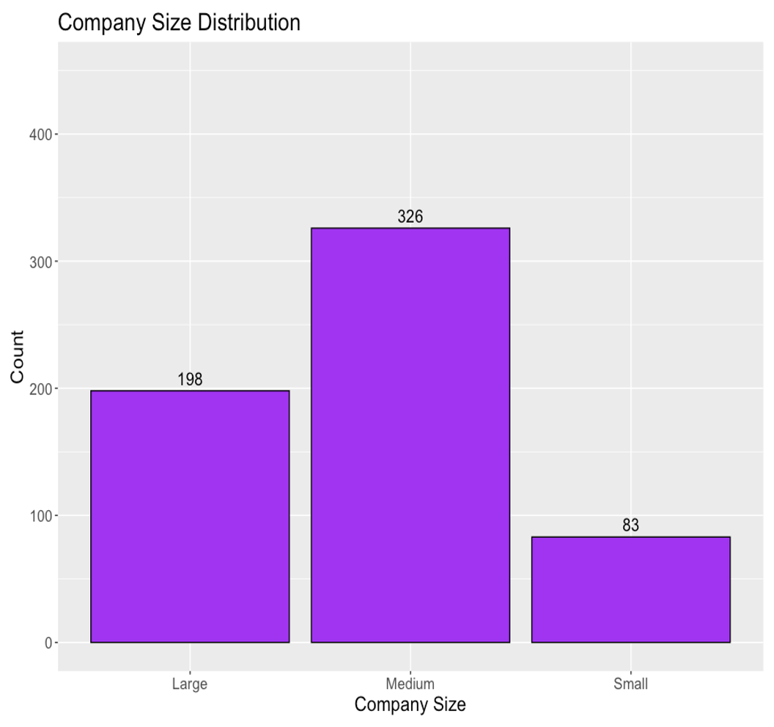
Data Visualization
Notes:
Distribution of Salary (USD):
Min: $2,859
1st Qu: $53,192
Median: $93,000
Mean: $107,471
3rd Qu; $145,000
Max: $600,000
Distribution of Remote Ratio: 607
Full Remote: 381 (62.8%)
No Remote: 127 (20.9%)
Half Remote: 99 (16.3%)
Distribution of Company Size: 607
Medium: 326 (53.7%)
Large: 198 (32.6%)
Small: 83 (13.7%)

Slide 12

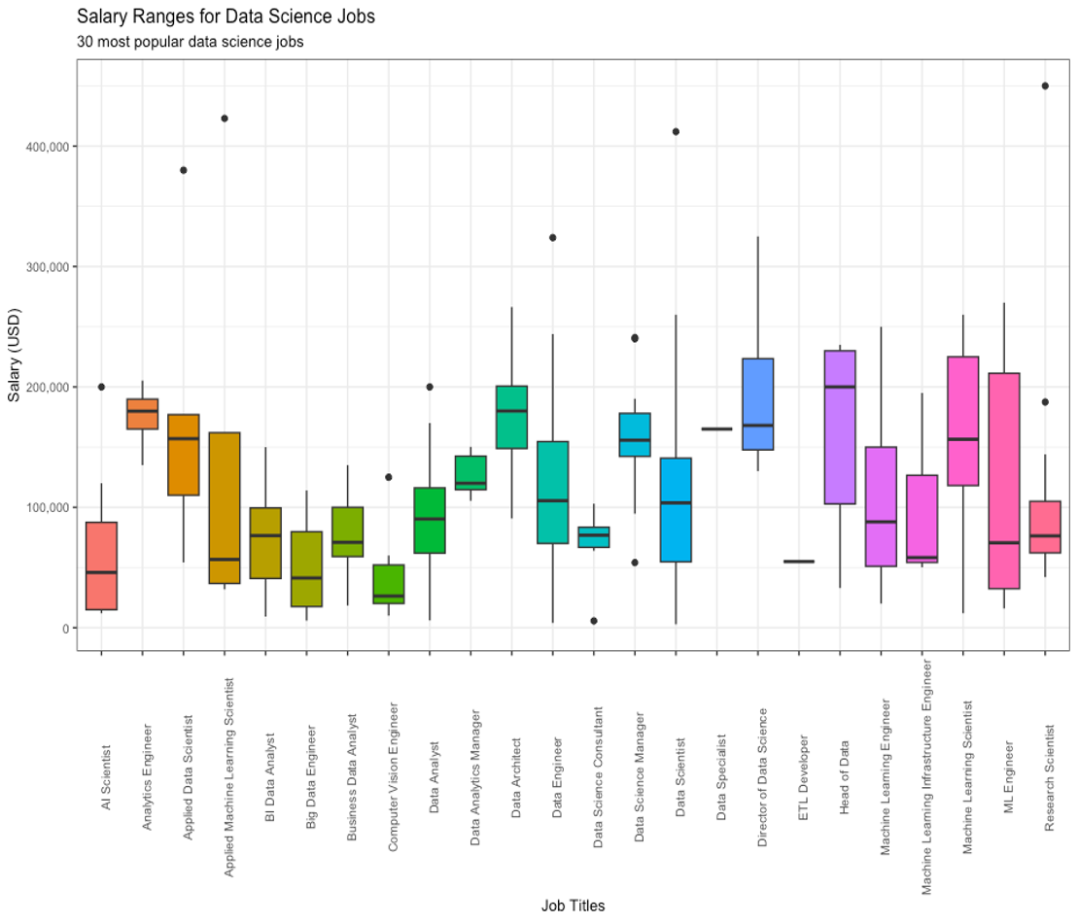
R A N G E S

Slide 13
Conclusion
In conclusion, this analysis provides a valuable snapshot of the current state and trends of data science salaries in the US, which can help data scientists and employers make informed decisions and plan their careers.

